Slide 1
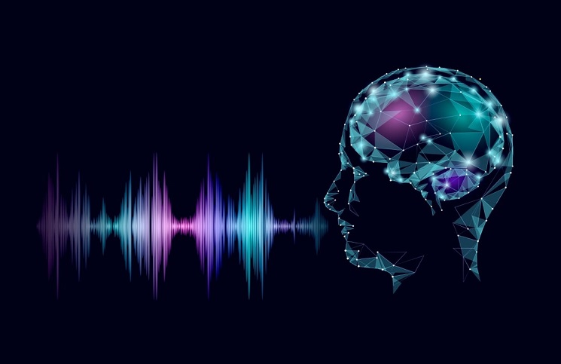
SPEECH EMOTION RECOGNITION
By
HARSHAD BANDI

Slide 2

INTRODUCTION
As human beings speech is amongst the most natural way to express ourselves. We depend so much on it that we recognize its importance when resorting to other communication forms like emails and text messages where we often use emojis to express the emotions associated with the messages. As emotion plays a vital role in communication, the detection and analysis of the same are of vital importance in today’s digital world of remote communication.
Human-machine interaction is widely used nowadays in many applications. One of the mediums of interaction is speech. The main challenge in human-machine interaction is the detection of emotion from speech.
Emotions can be detected from different physiological signal also. If emotion can be recognized properly from speech then a system can act accordingly. Identification of emotion can be done by extracting the features or different characteristics from the speech and training needed for a large number of speech database to make a system accurate.

Slide 3

PROBLEM STATEMENT
To build a model to recognize emotion from speech using the librosa and sklearn libraries and the RAVDESS dataset.
To present a classification model of emotion elicited by speeches based on deep neural network MLP Classification based on acoustic features such as Mel Frequency Cepstral Coefficient (MFCC). The model has been trained to classify eight different emotions (calm, happy, fearful, disgusted, angry, neutral, surprised and sad.)

Slide 4




Methodology of Project
Requirement Analysis
Collection and Understanding Dataset.
Exploratory Data Analysis
The dataset is being investigated to discover hidden patterns and anomalies.
Enhancing performance
The performance of model is improved by again refining the data and building the model again.
Performance Testing
After creating the model the performance of the model is being tested.

Slide 5
TECHNIQUES USED BY PROJECT
Data augmentation is a set of techniques to artificially increase the amount of data by generating new data points from existing data. This includes making small changes to data or using deep learning models to generate new data points
1
Data augmentation
MFCC Feature Extraction
2
The MFCC feature extraction technique basically includes windowing the signal, applying the DFT, taking the log of the magnitude, and then warping the frequencies on a Mel scale, followed by applying the inverse DCT

Slide 6
ABOUT
DATASET
24 Actors
7356
Total Files
12 Female
12 Male
The Ryerson Audio-Visual Database of Emotional Speech and Song (RAVDESS)
The Ryerson Audio-Visual Database of Emotional Speech and Song (RAVDESS) contains 7356 files. The database contains 24 professional actors (12 female, 12 male), vocalizing two lexically-matched statements in a neutral North American accent. Speech includes calm, happy, sad, angry, fearful, surprised, and disgusted expressions and the song contains calm, happy, sad, angry, and fearful emotions.

Slide 7


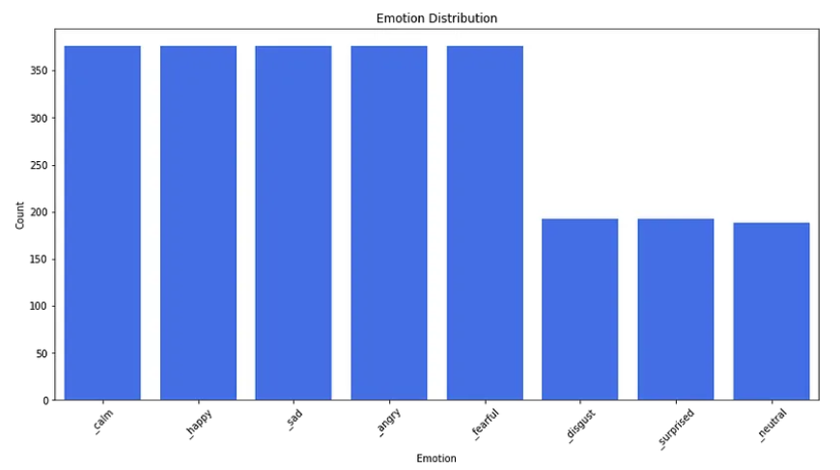
FEATURE DETAILS
12 Actors & 12 Actresses recorded speech and song versions respectively.
Actor no.18 does not have song version data.
Emotion Disgust, Neutral and Surprised are not included in the Song Version Data.
Here is the emotion class distribution bar chart

Slide 8
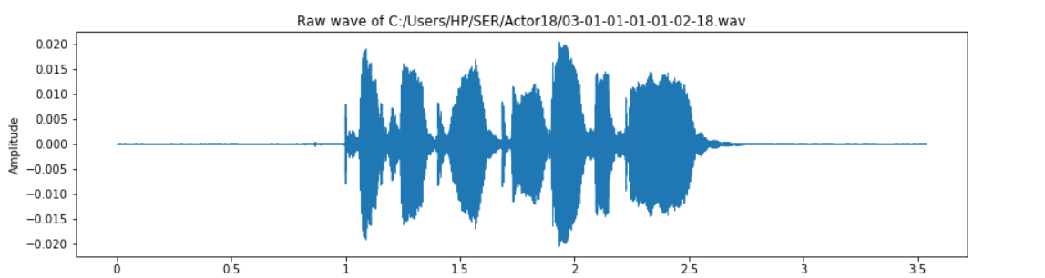
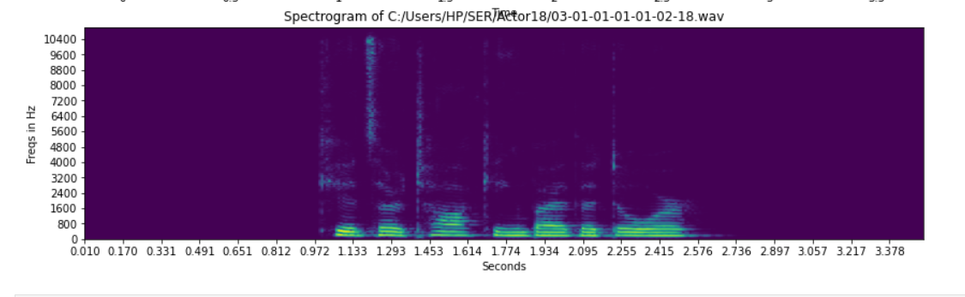
Exploratory Data Analysis refers to the critical process of performing initial investigations on data so as to discover patterns, to spot anomalies, test hypothesis and to check assumptions with the help of summary statistics and graphical representations
Exploratory Data Analysis(EDA)

Slide 9
Analysis
In the RADVESS dataset, each actor has to perform 8 emotions by saying and singing two sentences and two times for each. As a result, each actor would induce 4 samples for each emotion except neutral, disgust and surprised since there is no singing data for these emotions. Each audio wave is around 4 second, the first and last second are most likely silenced.
The standard sentences are:
1. Kids are talking by the door.
2. Dogs are sitting by the door.
After I selected 1 actor and 1 actress’s dataset and listened to all of them. I found out male and female are expressing their emotions in different way. Here are some findings:
Male’s Angry is simply increased in volume.
Male’s Happy and Sad significant features were laughing and crying tone in the silenced
period into the Audio.
Female’s Happy, Angry and Sad are increased in volume.
Female’s Disgust would add vomiting sound inside.

Slide 10
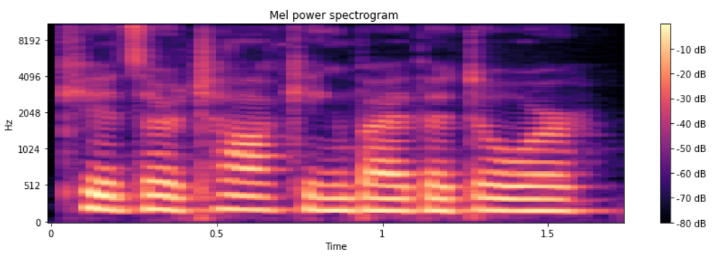
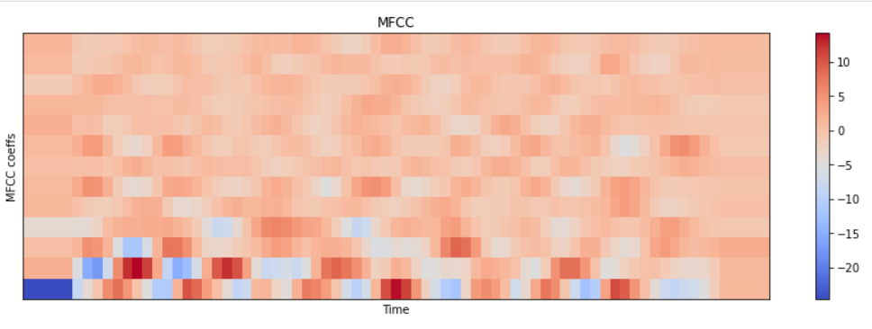
Mel Power Spectrogram Vs Time
MFCC Vs Time

Slide 11
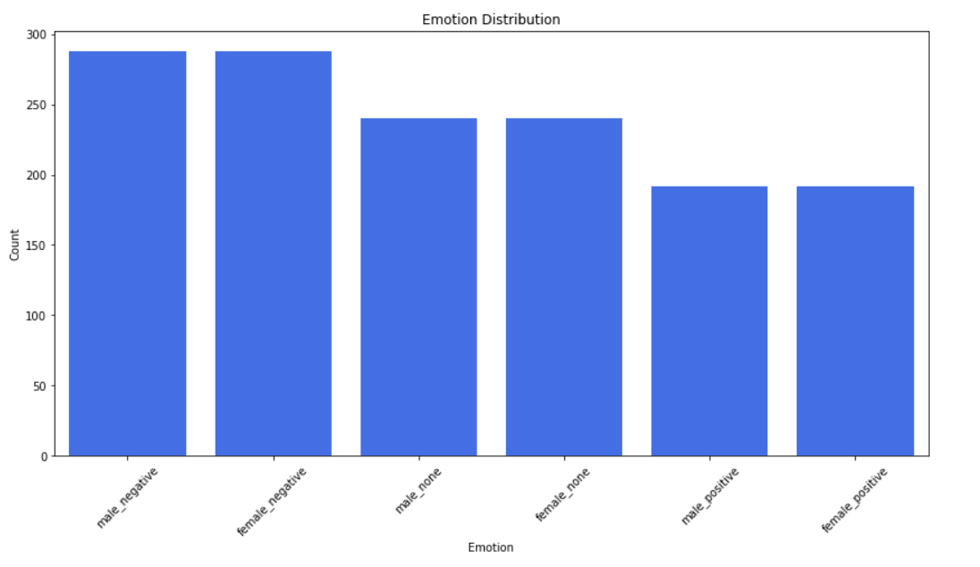
Distribution with respect to Gender
FEMALE
MALE
We see that in Female Category there are more counts of Negative Emotions compared to Positive Emotions.
We can say there is Slight Difference.
We observe that In Male Category there are more count of Negative Emotions compared to Positive Emotions.
VS
None(Neutral)
In None i.e Neutral Emotions the Counts are equally distributed between Male and female.

Slide 12
Data Augmentation
After I tuned the model architecture, optimizer and learning rate schedule, I found out the model still cannot converge in the training period. I assumed it is the data size problem since we have 800 samples for train valid set only. Thus, I decided to explore the audio augmentation methods. Let’s take a look at some augmentation method with code. I simply augmented all of the datasets once to double the train / valid set size.
White Noise Adding
Additive white Gaussian noise (AWGN) is a basic noise model used in information theory to mimic the effect of many random processes that occur in nature
Stretching the Sound
The process of changing the speed/duration of sound without affecting the pitch of a sound.

Slide 13
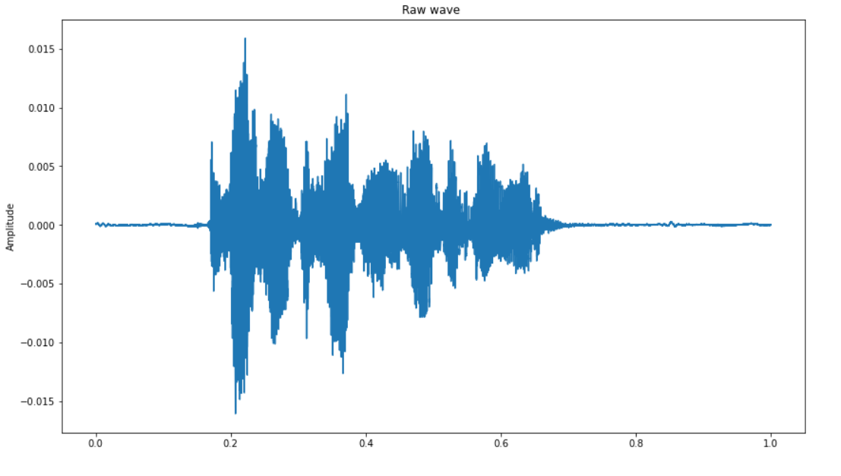
Pitch Tuning
It is a process of changing the pitch of sound without affect it’s speed. It is an implementation of pitch scaling used in musical instruments.
Visualization of Spectrogram after Augmentation
Raw Wave Vs Amplitude

Slide 14
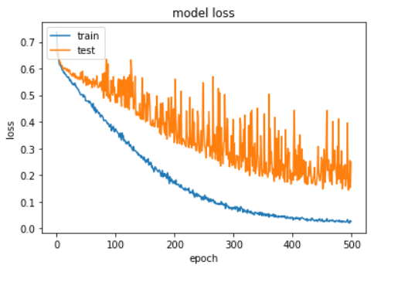
MODEL
Convolutional Neural Network (CNN)
Within Deep Learning, a Convolutional Neural Network or CNN is a type of artificial neural network, which is widely used for recognition and classification. It consists of multiple layers, including Convolutional layers, Pooling layers, and fully connected layers. The network learns the optimal filters through backpropagation and gradient descent.
After Running for 500 Epochs

Slide 15
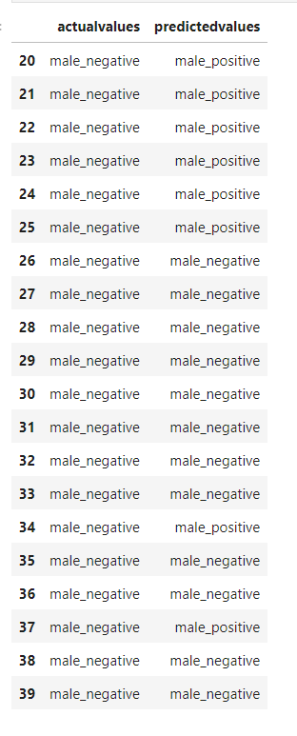
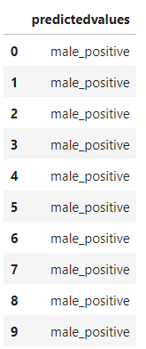
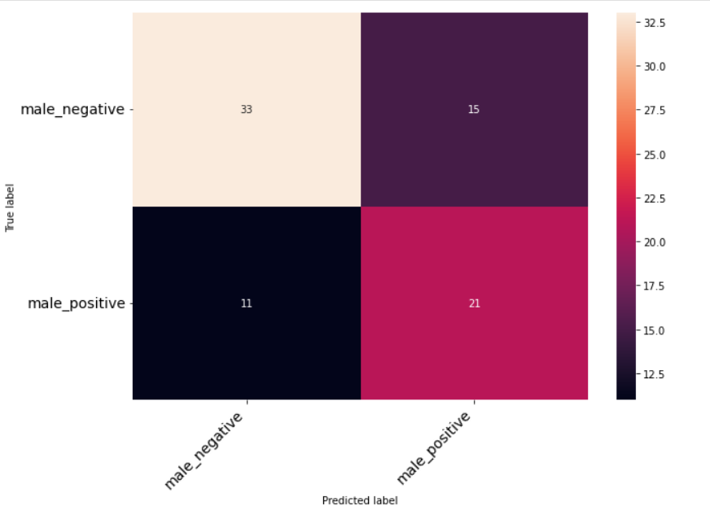
RESULTS
Actual Vs Predicted
Predicted Values
Confusion Matrix

Slide 16



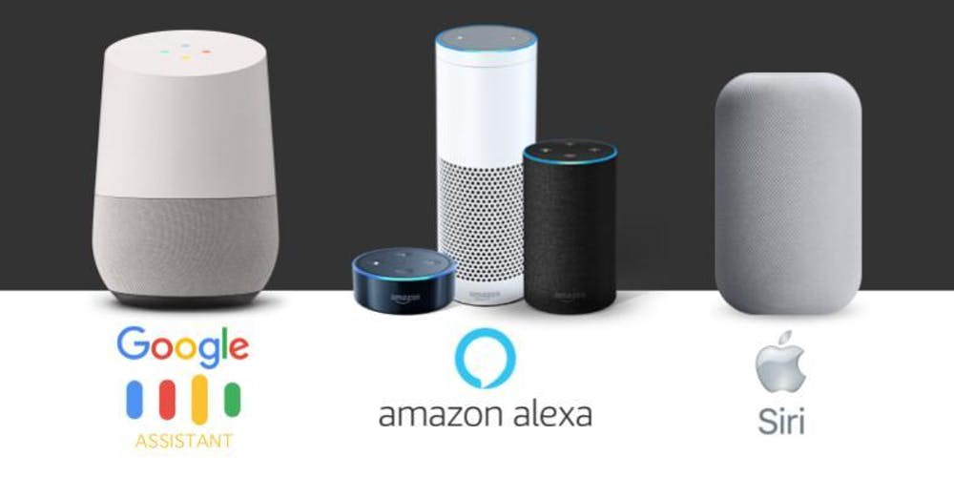

Business Applications
01. Voice Assistant
02. Business Marketing
03. Stress monitoring and Lie Detection
04. Chaos Alert System.

Slide 17

FUTURE ENHANCEMENT
Develop a mobile app
Develop an application for various organizations.
Research
We can integrate our model with the IOT and android app which keeps on tracking our Emotions and give the best Suggestions based on our Emotions.
With the data of various institutions, we can develop speaking bots which can make human interactions with Emotions and react according to their Emotions.
We can perform more deep research on this topic and develop
more accurate model using advanced algorithms.

Slide 18
Advantages & Disadvantages
Advantages
Will help companies establish deep emotional connections with their consumers and bring productive change in Customer Relationship management.
Can bring a remarkable change in the field of Security Systems and Alert systems.
Will be helpful for improving the lifestyle of people and keeping their routine balanced
and Healthy.
Disadvantages
It’s very difficult for one to get a continuous record of Speech or voice from the user to predict the overall emotions.
Recording Voice without user permission or listening to other’s conversations may break
or dishonour Privacy term
s and Conditions.

Slide 19

Thank you

